Slide 1
Working Capital Management

Slide 2
Introduction:
Working Capital Management: Management of the current assets held by a firm is known as working capital management. It involves the administration, control, procurement and financing of current assets. Current assets include cash marketable securities, short-terms investments, accounts receivable inventory, and so on and financing of current assets include current liabilities and bank borrowing. Thus working capital management deals with funds involved in the day-to-day operations of the firm.
Concepts of Working Capital
There are two concepts of working capital- gross and net.
Gross Working Capital (Total Current Assets)
Net Working Capital (Current assets – Current Liabilities)

Slide 3
The Objectives of Working Capital Management
Liquidity
To maintain an optimum level of current assets
Total working capitals composed of two parts are known as
(i) Permanent Working Capital
(ii) Variable Working Capital
Variable Working Capital
Amount of Working Capital (Rs.)
Permanent Working Capital
Time

Slide 4
Balanced Working Capital Position
The firm should maintain a sound working capital position. It should have adequate working capital to run its business operations. Both excessive as well inadequate working capital positions are dangerous from the firm’s point of view.
The dangers of excessive working capital are as follows:
It results in unnecessary accumulation of inventories. Thus chances of inventory mishandling, waste, theft and losses increase.
It is an indication of defective credit policy and slack collection period. Consequently, higher incidence of bad debts results, which adversely affects profits.
Excessive working capital makes management co placement which degenerates into managerial inefficiency.
Inadequate working capital is also bad and has the following dangers:
It stagnates growth. It becomes difficult for the firm to undertake profitable projects for non- availability of working capital funds.
It becomes difficult to implement operating plans and achieve the firm’s profit target.
Operating inefficiencies creep in when it becomes difficult even to meet day-to-day commitments.
Fixed assets are not efficiently utilized for the lack of working capital funds. Thus, the firm profitability would deteriorate.
Paucity of working capital funds render the firm unable to avail attractive credit opportunities etc.
The firm loses its reputation when it is not in a position to honour its short-term obligations. As a result, the firm faces tight credit terms.

Slide 5
Factors affecting working capital
The following factors determine the amount of working capital:
Nature of Business: Service company versus manufacturing company
Service firms have short operating cycle, as they work predominantly on cash basis; need less WC.
Manufacturing companies have long operating cycle; sell largely on credit; they have heavy WC requirements.
Seasonality of Operations: Fluctuating working capital for a firm with seasonality in operations. For example, manufacturer of ceiling fans, sweaters and other woolen clothes.
Production Policy: Based on seasonality in operations, a firm may choose between steady production, level production, or intensified production during peak business period. Accordingly change the working capital requirements.
Market Conditions: Factors such as competition prevailing in the market (e.g., premium automobiles), availability of credit (e.g., advance money demanded by real estate firms), and macroeconomic factors (e.g., interest rate).
Conditions of Supply: A firm’s relations with other players in the ecosystem affect the supply of raw materials, spares, stores, etc. If supply is assured and prompt when demanded, the working capital requirements are less.

Slide 6
Operating Cycle:
Working capital is also called a circulating capital or revolving capital. That is the money/capital which circulates in various forms of current assets in a continued manner. For example, at a point of time, funds may be tied up in raw materials and then later converted into semi-finished products, then into finished/ final products and when these finished products are sold, it is converted either into account receivables or cash.
Cash
Raw Material
Semi- Finished Goods
Finished Goods
Bills Receivables

Slide 7
Policies for Financing Current Assets:
Spontaneous financing- Spontaneous financing refers to the automatic sources of short-term funds arising in the normal course of a business. Trade (suppliers) credit and outstanding expenses are examples of spontaneous financing.
Short-term financing – The short-term financing is obtained for a period less than one/year. It is arranged in advance from banks and other suppliers of short-term finance in the money market. Short-term finances include working capital funds from banks, public deposits, commercial paper, factoring of receivable etc.
Long-term financing- The sources of long-term financing include ordinary share capital, preference share capital debentures, long-term borrowing from financial institutions

Slide 8
What should be the mix of short and long-term financing the approach following by a company may be referred to as:
Matching approach
Conservative approach
Aggressive approach
Matching Approach
The firm can adopt a financial plan which matches the expected life of assets with the expected life of the source of funds raised to finance assets. Thus a ten-year loan may be raised to finance a plant with an expected life of ten years; stock of goods to be sold in thirty days may be financed with a thirty day commercial paper or a band loan.

Slide 9
Conservative/Flexible Policy:
A firm in practice may adopt a conservative approach in financing its current and fixed assets. The financing policy of the firm is said to be conservative when it depends more on long-term funds for financing needs under a conservative plan, the firm finances its permanent assets and also as part of temporary current assets with long-term financing.
Restrictive/Aggressive Policy:
A firm may be aggressive in financing its assets. An aggressive policy is said to be followed by the firm when it uses more short-term financing than warranted by the matching plan. Under an aggressive policy, the firm finances a part of its permanent current assets with short-term financing.

Slide 10
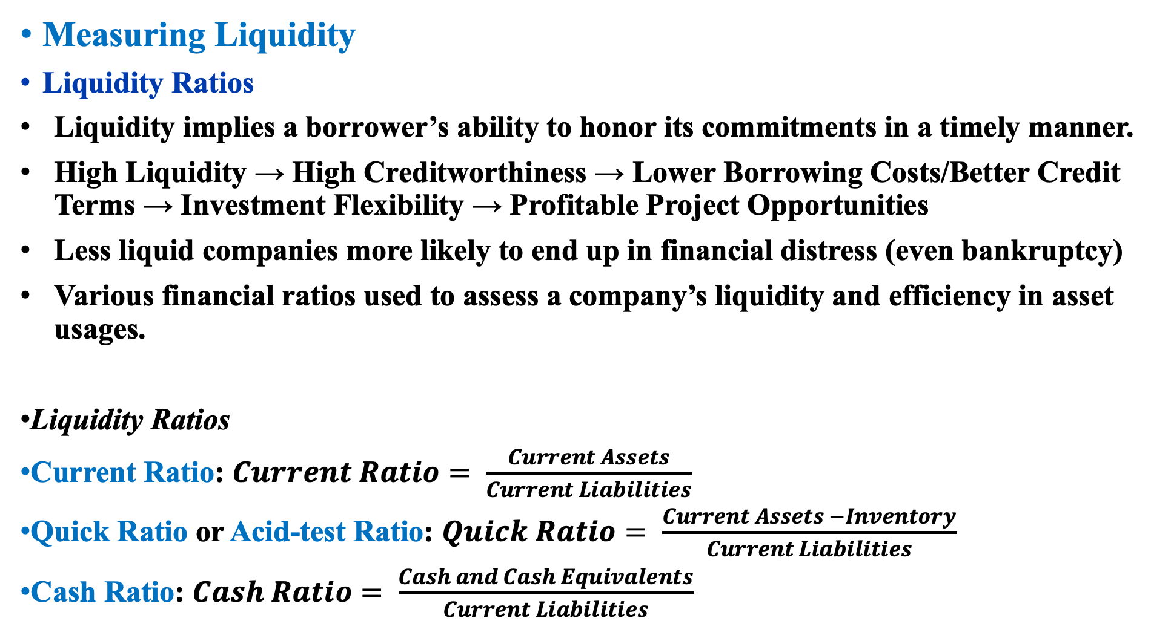
Measuring Liquidity
Liquidity Ratios
Liquidity implies a borrower’s ability to honor its commitments in a timely manner.
High Liquidity → High Creditworthiness → Lower Borrowing Costs/Better Credit Terms → Investment Flexibility → Profitable Project Opportunities
Less liquid companies more likely to end up in financial distress (even bankruptcy)
Various financial ratios used to assess a company’s liquidity and efficiency in asset usages.
Liquidity Ratios
Current Ratio: $Current Ratio= \frac{Current Assets}{Current Liabilities}$
Quick Ratio or Acid-test Ratio: $Quick Ratio= \frac{Current Assets −Inventory}{Current Liabilities}$
Cash Ratio: $Cash Ratio= \frac{Cash and Cash Equivalents}{Current Liabilities}$

Slide 11
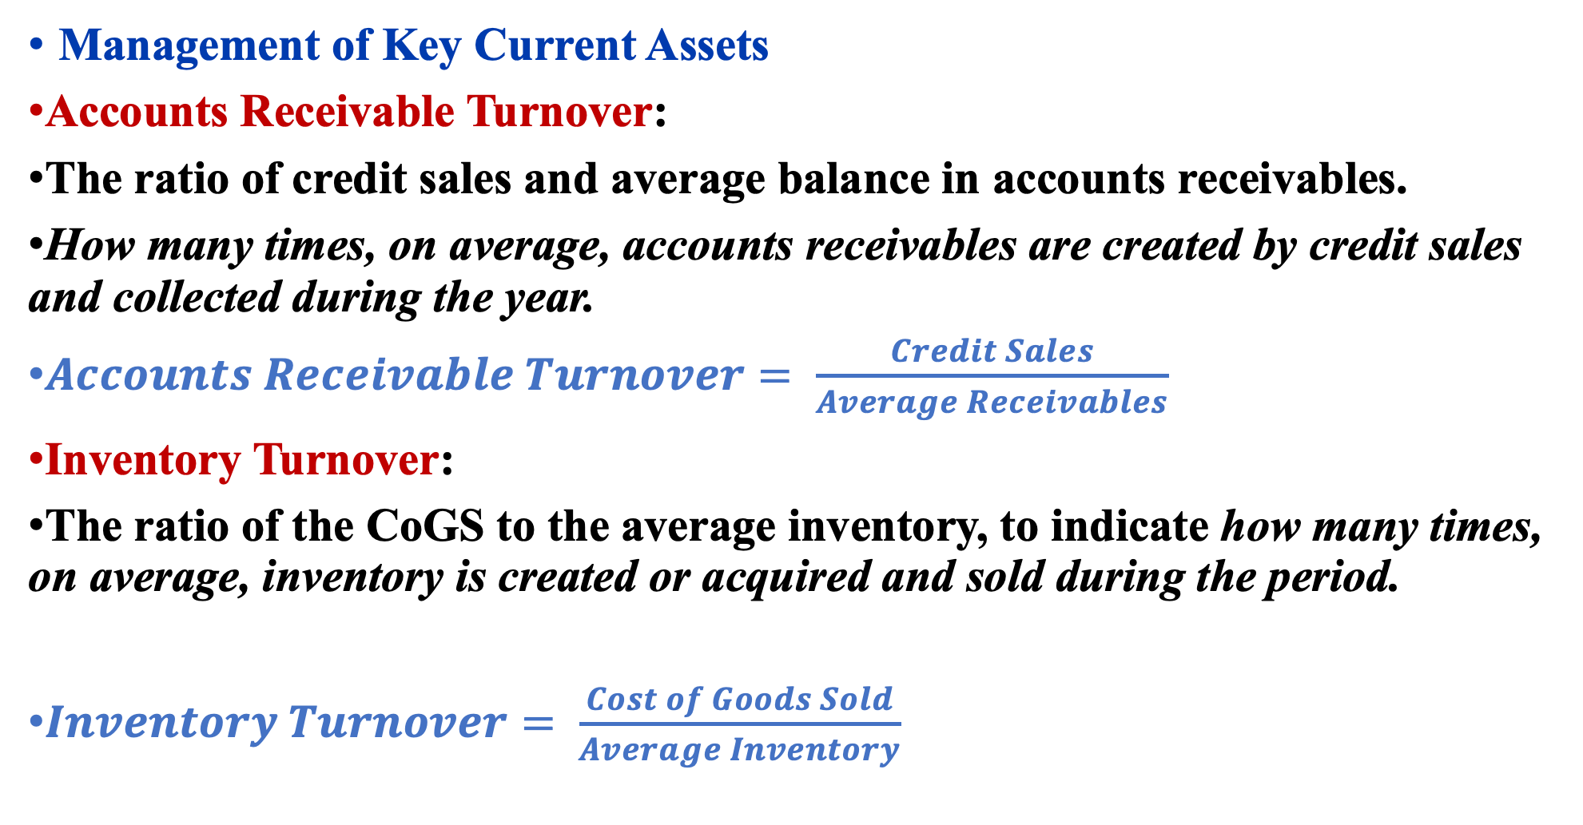
Management of Key Current Assets
Accounts Receivable Turnover:
The ratio of credit sales and average balance in accounts receivables.
How many times, on average, accounts receivables are created by credit sales and collected during the year.
$Accounts Receivable Turnover= \frac{Credit Sales}{Average Receivables}$
Inventory Turnover:
The ratio of the CoGS to the average inventory, to indicate how many times, on average, inventory is created or acquired and sold during the period.
$Inventory Turnover= \frac{Cost of Goods Sold}{Average Inventory}$

Slide 12
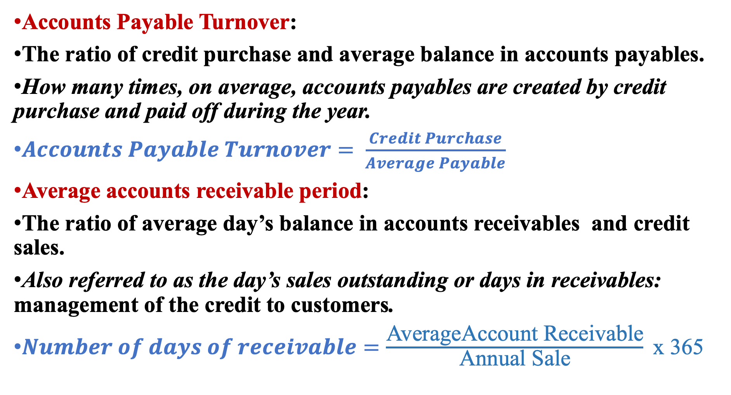
Accounts Payable Turnover:
The ratio of credit purchase and average balance in accounts payables.
How many times, on average, accounts payables are created by credit purchase and paid off during the year.
$Accounts Payable Turnover= \frac{Credit Purchase}{Average Payable}$
Average accounts receivable period:
The ratio of average day’s balance in accounts receivables and credit sales.
Also referred to as the day’s sales outstanding or days in receivables: management of the credit to customers.
$Number of days of receivable=\frac{\text{AverageAccount} \text{Receivable}}{\text{Annual} \text{Sale}} \text{x}\text{ 365}$

Slide 13
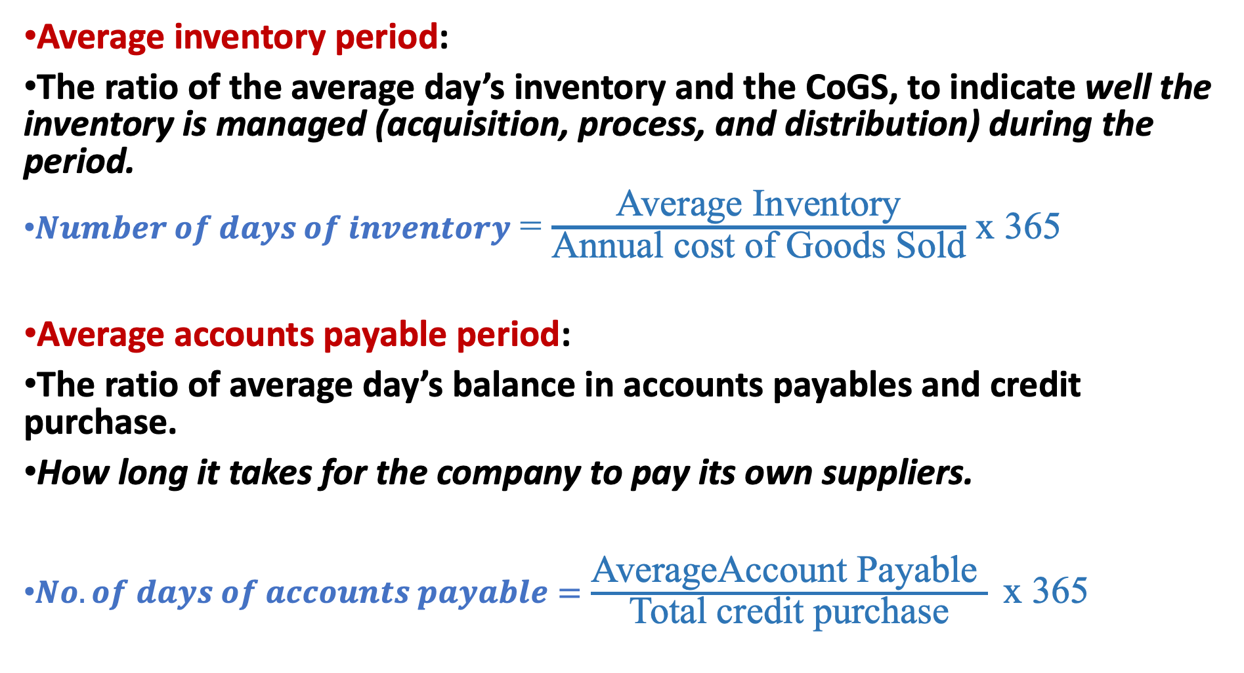
Average inventory period:
The ratio of the average day’s inventory and the CoGS, to indicate well the inventory is managed (acquisition, process, and distribution) during the period.
$Number of days of inventory$ = $\frac{\text{Average} \text{Inventory}}{\text{Annual} \text{cost} \text{of} \text{Goods} \text{Sold}}$ x 365
Average accounts payable period:
The ratio of average day’s balance in accounts payables and credit purchase.
How long it takes for the company to pay its own suppliers.
$No. of days of accounts payable=\frac{\text{AverageAccount} \text{Payable} }{\text{Total} \text{credit} \text{purchase}} \text{x}\text{ 365}$

Slide 14
The formula to calculate operating cycle
Stock Arrives
Finished Good Sold
Cash Received
Order Placed
Inventory Period
Account Receivables Period
Account payables Period
Cash Paid for Materials
Operating Cycle
Cash Cycle

Slide 15
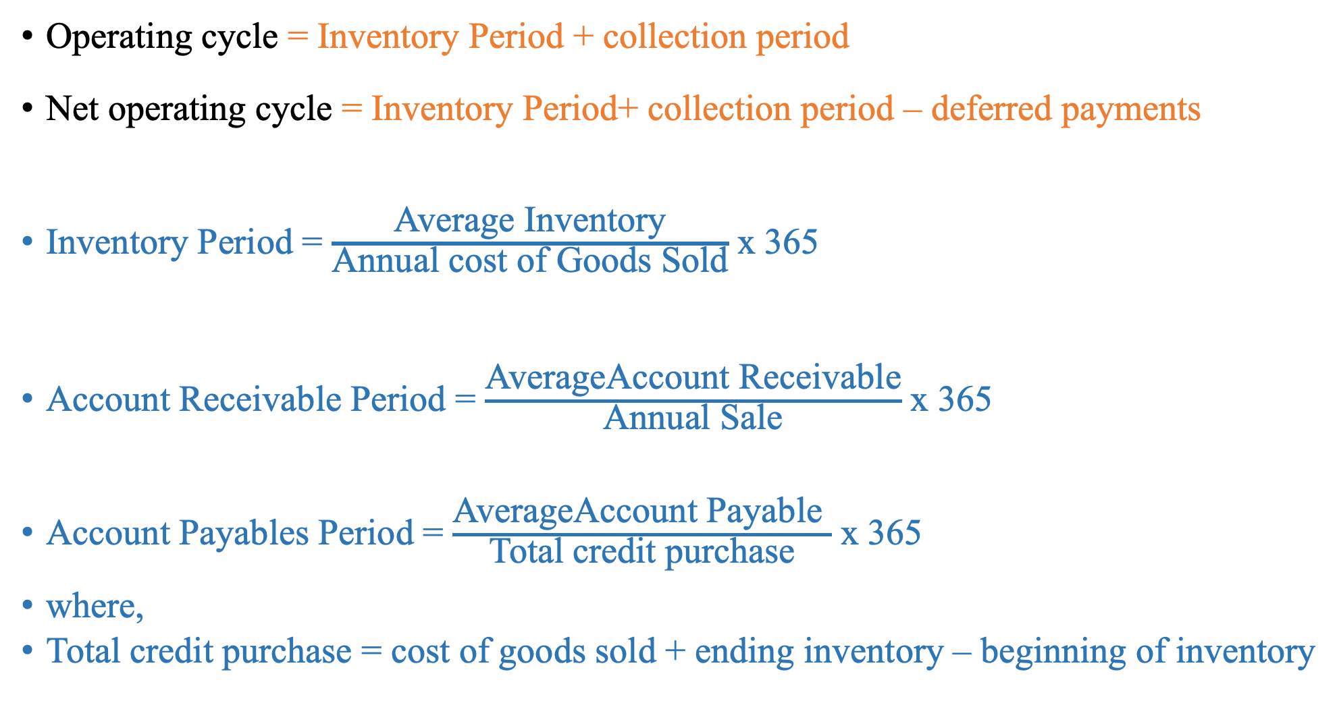
Operating cycle = Inventory Period + collection period
Net operating cycle = Inventory Period+ collection period – deferred payments
Inventory Period = $\frac{\text{Average} \text{Inventory}}{\text{Annual} \text{cost} \text{of} \text{Goods} \text{Sold}}$ x 365
Account Receivable Period = $\frac{\text{AverageAccount} \text{Receivable}}{\text{Annual} \text{Sale}}$ x 365
Account Payables Period = $\frac{\text{AverageAccount} \text{Payable} }{\text{Total} \text{credit} \text{purchase}}$ x 365
where,
Total credit purchase = cost of goods sold + ending inventory – beginning of inventory

Slide 16
For calculating net operating cycle, various conversion periods may be calculated as follows:
Raw material cycle period (RMCP)= (Average Raw material stock/Total raw material Consumable) x 365
Working progress cycle period (WPCP) = (Average work in progress/ Total cost of Production) x 365
Finished goods cycle period (FGCP) = (Average finished goods/Total cost of goods Sold) x 365
For above calculations, the following points are essential
1. The average value is the average of opening balance and closing balance of the respective items. In case the opening balance is not available, only the closing balance is taken as the average.
The figure 365 represents number of days in a year. Sometimes even 360 days are considered.
The calculation of RMCP, WPCP and FGCP the denomination is taken as the total cost raw material consumable, total cost of production, total cost of goods sold respectively since they form respective end products.

Slide 17
Example: Financial Information for Horizon Limited
 | Profit & Loss Account Data | Balance sheet Data
 |  |  | Beginning of 20X0 | End of 20X0
Sales | 800 | Inventory | 96 | 102
Cost of Good Sold | 720 | Trade Receivable | 86 | 90
 |  | Trade Payables | 56 | 60

Slide 18
Accounts receivable period =
Accounts payable period =
Operating cycle = 50.1 + 40.2 = 90.3 days
Inventory period Accounts receivable
period
Cash cycle = 90.3 - 29.2 = 61.1days
Operating cycle Accounts payable period
(96 + 102) /2
720
Inventory period =
X 365 = 50.1 days
(86 + 90) /2
800
X 365 = 40.2days
(56 + 60) /2
726
X 365 = 29.2 days

Slide 19
Cash Requirement for working Capital
Step 1: Estimate the cash cost of various current assets required by the firm. The cash cost of current assets is:
value of the current assets minus
-profit element if any include in the value
-non cash charge like depreciation, if any, include in the value.
Step 2: Deduct the spontaneous current liabilities from the cash cost of current assets. A portion of the case cost of current assets is supported by the trade credit and accruals of wages on expenses, which may be referred to as spontaneous current liabilities. The balance left after such deduction has to be arranged from the other sources.

Slide 20
Q. Max Limited sells goods at a profit margin of 25 percent, counting depreciation as part of the cost o manufacture. Its annual figures are as follows:
Sales (Two months credit is given)months credit is given) | Rs. 240 Million
Material cost (Suppliers give three months credit) | 72
Wages (Wages are paid one month in arrears) | 48
Manufacturing expenses outstanding at the end of the year (Cash expenses are paid one month in arrears) | 4
Administrative and sales expenses (These are paid as incurred) | 30
Max Limited keeps two months' stock of raw materials and one month's stock of finished goods. It wants to maintain a cash balance of 5 million. Estimate the requirement of working capital on cash cost basis, assuming a 10 percent safety margin. Ignore work-in-process.

Slide 21
A: Current assets
Item | Calculation | Amount (Rs. In Million
Debtors | Total cash cost x 2/12 = 198 X 2/12 | 33.00
Raw Materials | Material cost x 2/12 = 72 X 2/12 | 12.00
Finished Good | Cash Manufacturing cost x1/12 =168/12 | 14.00
Cash Balance | A predetermined amount | 5
 | A: Current Assets | 64.0
B: Current Liabilities
Item | Calculation | Amount (Rs. In Million
Sundry Creditors | Material cost x 3/12 = 72 X 3/12 | 18
Manufacturing expenses outstanding | One month's cash manufacturing expenses | 4.00
Wages outstanding | One month's wages | 4.00
 | B: Current Liabilities | 26

Slide 22
Working Capital (A-B) = 64.00 - 26.00 = 38.00
Add 10 percent safety margin 3.8
Working capital required 41.8

Slide 23
Working Notes
1. Sales
Less: Gross profit (25%)
Total manufacturing cost
Less: Materials 72
Wages. 48
Manufacturing expenses
2. Cash manufacturing expenses
(4Million x 12)
3. Depreciation: (1) -(2)
4. Total cash cost
Total manufacturing cost
Less: Depreciation
Cash manufacturing cost
Add Total administrative and selling expenses
Total cash cost
240
60
180
120
60
48
12
180
12
168
30
198

Slide 24
Thank You
& All the Best
Reference : Prasanna Chandra Financial Management 10th edition book

